Slide 1
Fire fighting Arduino Robot

Slide 2
Table of contents
02
01
03
components
CIRCUIT
code

Slide 3
components

Slide 4
components
Water Pump
Arduino Uno
L298N Motor Driver
Breadboard
Flame Sensor
Mini Servo
Brain of the robot; processes sensor data and controls motors.
Moves the robot forward, backward, and turns it.
Controls motor direction and speed based on Arduino signals.
Connects components without soldering; allows easy circuit assembly and testing.
Detects fire presence.
Controls small movements, like turning a nozzle or adjusting direction.

Slide 5
components
Water Pump
Li-ion Battery (3.7V)
L298N Motor Driver
99pF Capacitor
Tip 122 transistor
Resistor:
Extinguishes the fire when robot reaches it.
Provides power to the robot and its components
Controls motor direction and speed based on Arduino signals.
Stabilizes voltage and reduces electrical noise in the circuit
Limits the electric current to protect components from damage.
Act like a switch .

Slide 6
02
CIRCUIT

Slide 7
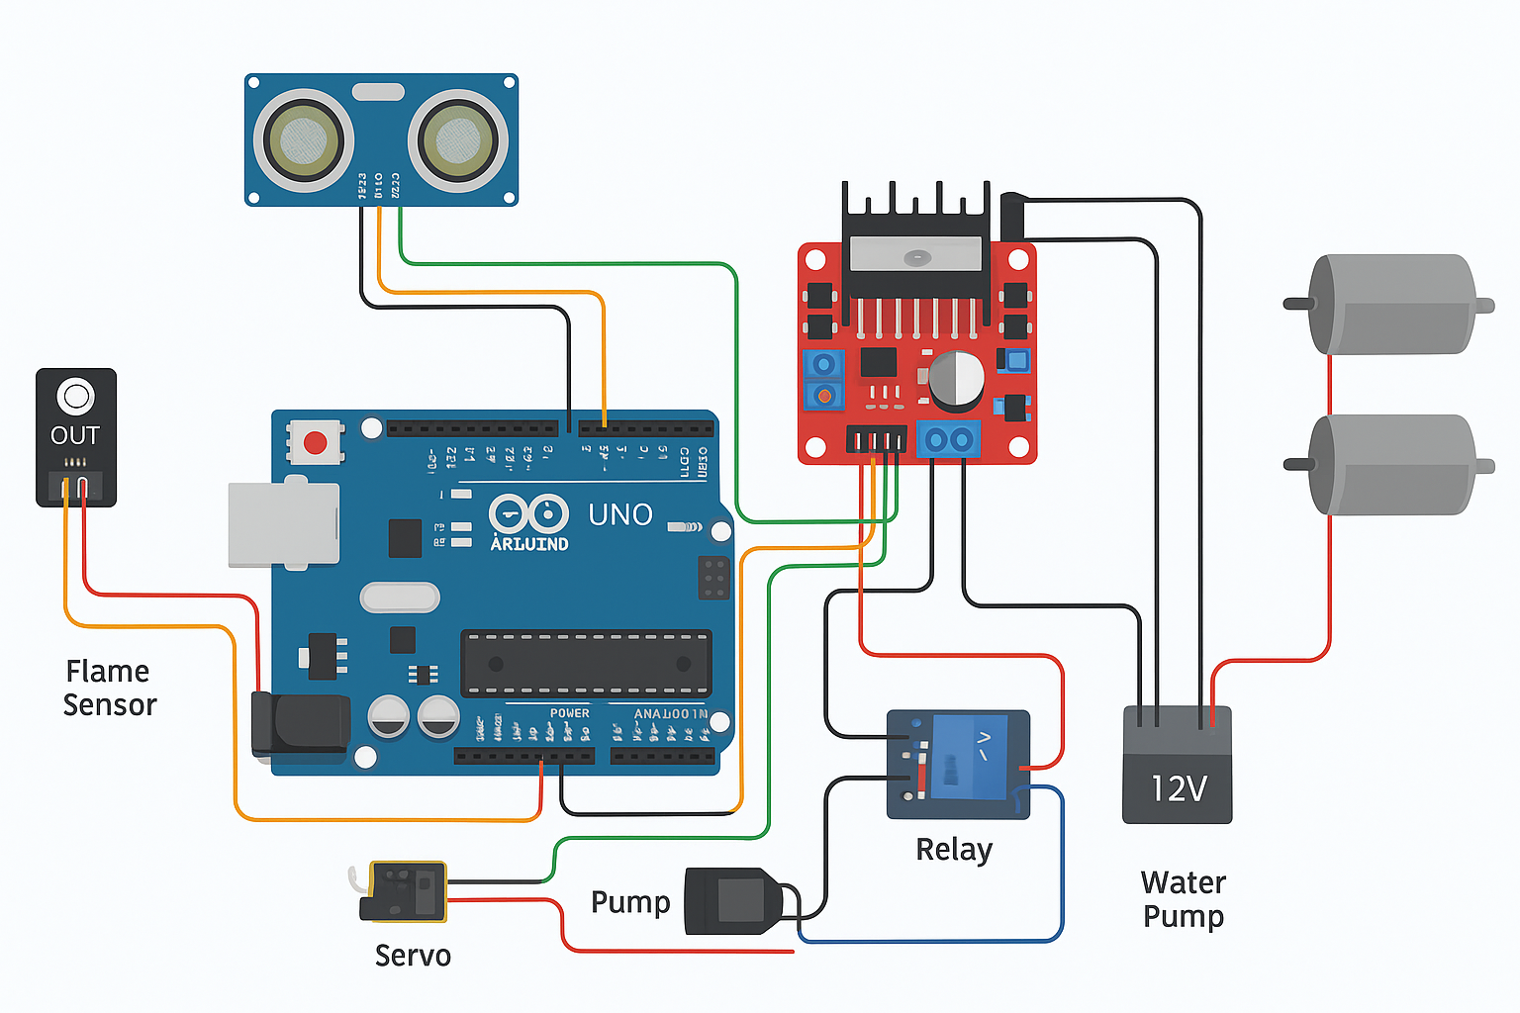
What we are working on
Retail
Residential
Hospitality
Mercury is the closest planet to the Sun and the smallest one
Venus has a beautiful name and is the second planet from the Sun
Despite being red, Mars is actually a cold place. It’s full of iron oxide dust

Slide 8
The code

Slide 9
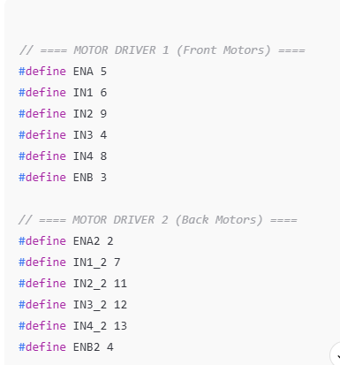
PINS DEFFENTIONS

Slide 10
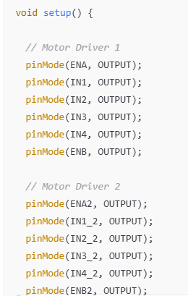
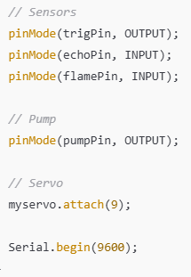
inMode sets each Arduino pin as INPUT (to read sensors) or OUTPUT (to control motors/pump). Motor pins = OUTPUT. trigPin = OUTPUT (sends pulse). echoPin = INPUT (receives pulse). myservo.attach() connects the servo to its control pin. Serial.begin() starts the Serial Monitor for printing values.

Slide 11
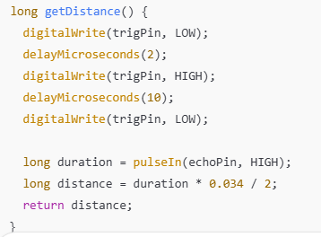
Trigger: LOW → HIGH → LOW with a 10 microsecond pulse. pulseIn: measures the duration for which echo stayed HIGH.

Slide 12
Trigger: LOW → HIGH → LOW with a 10 microsecond pulse. pulseIn: measures the duration for which echo stayed HIGH.

Slide 13
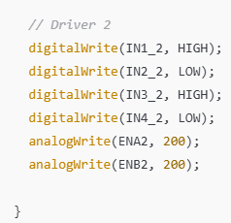
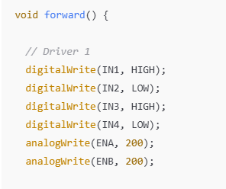
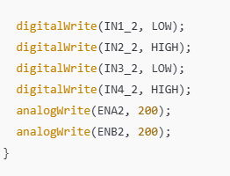
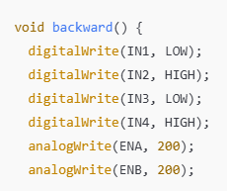
Each motor has two pins: HIGH + LOW → moves forward LOW + HIGH → moves backward LOW + LOW → stops analogWrite: to control speed (0–255).

Slide 14
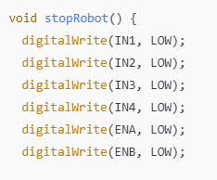
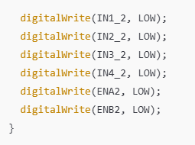
Set all pins LOW → no current → no movement.

Slide 15
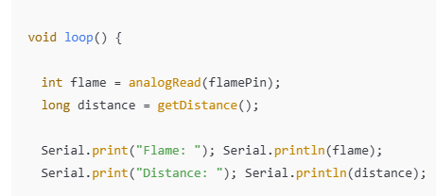
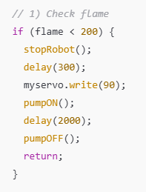
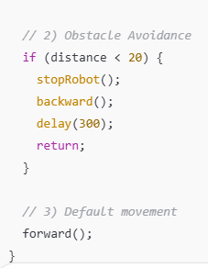
Read flame and distance sensors. If flame detected → stop, aim servo, turn on pump for 2 seconds. If obstacle detected → stop and move backward briefly. Otherwise → move forward.

Slide 16
Thank you!

